Slide 1
Title IX & Sexual Violence Investigations
April 20, 2023
Office of Equity and Inclusion
Desiree’ Clark
Civil Rights, Title IX/Compliance Officer
Office of Equity & Inclusion
Scott Goings
General Counsel
Office of General Counsel
Ashley Atteberry
Associate Compliance Officer
Office of Equity & Inclusion
Linda Álvarez
Director of Equal Opportunity & Title IX
Minnesota State University, Mankato
Minnesota State

Slide 2
Outline of Today’s Presentation
Review System Procedure 1B.3.1
Laws and Policies
Forms of Discrimination
Sexual Violence Background
Pre-Investigation Planning
Conducting Interviews and Trauma Informed Care
Affirmative Consent, Intoxication verses Incapacitation and Informal Resolution
Resources
Questions/Discussion

Slide 3
What Is Title IX?
Title IX is a federal civil rights law prohibiting sex discrimination in all facets of the educational setting
By accepting federal funds, institutions agree not to discriminate on the basis of sex or allow the separation of the sexes in curriculum and extracurricular activities, unless permitted by the statute
Failure to comply may result in liability on the part of the institution

Slide 4
Title IX
No person in the United States shall, on the basis of sex, be excluded from participation in, be denied the benefits of, or be subjected to discrimination under any education program or activity receiving federal financial assistance.
        20 U.S.C. §1681 (1972)

Slide 5
Timeline
November 16, 2018 US Department Of Education (DOE) Notice of Proposed Rule-making.
Final Rule published on May 6, 2020 -- effective on August 14, 2020.
Revised System Procedure 1B.3.1 finalized on August 14, 2020.
Biden administration releases proposed new regulations on June 23, 2022.
Comment period closed on September 12, 2022 (approximately 240,000 comments).

Slide 6
Overall Process Map
Old 1B.3.1 Procedure
  Complaint, Investigation, Decision-maker, internal appeal, Ch. 14 if serious student sanction.
New 1B.3.1 Procedure
  Formal Complaint, Investigation (with enhanced requirements), Ch. 14 hearing, Decision-maker, internal appeal.
Also consider Policy 1B.1 and student conduct processes for non-Title IX sexual harassment and jurisdiction.
Basic legal responsibility = deliberately indifferent standard.

Slide 7
Three Quick Deliverables (or To Do’s)
Update your web-sites and information to the new System Procedure 1B.3.1.
Notice of Title IX Coordinator.
Notice of Non-Discrimination.

Slide 8
Notice of Title IX Coordinator
Each college and university must notify applicants for admission and employment, students, employees, and all unions holding collective bargaining agreements with the college or university of the name or title, office address, electronic mail address, and telephone number of the employee or employees designated at the Title IX Coordinator.

Slide 9
Notice of Non-Discrimination
Each college and university must notify applicants for admission and employment, students, employees and all unions holding collective bargaining agreements with the college and university that the college or university does not discriminate on the basis of sex in the education program or activity that it operates, and that it is required by Title IX not to discriminate in such a manner. Inquiries about the application of Title IX may be referred to the Title IX Coordinator and/or the United States Department of Education.

Slide 10
Key Elements of the New Procedure

Slide 11
Definition of Title IX Sexual Harassment
Conduct based on sex that occurs in a college or university’s program or activity in the United States that satisfies on or more of the following:
  An employee of the college or university conditioning the provision of an aid, benefit, or service of the recipient on an individual’s participation in unwelcome sexual conduct;
  Unwelcome conduct determined by a reasonable person to be so severe, pervasive and objectively offensive that it effectively denies a person equal access to the college or university’s education program or activity; or
  Sexual assault, dating, intimate partner, and relationship violence; and stalking as defined in Board Policy 1B.3.

Slide 12
Formal Complaint
Defined as
  Document filed by a complainant or signed by the Title IX Coordinator alleging Title IX sexual harassment against a respondent and requesting investigation.
  At the time of filing a formal complaint of Title IX sexual harassment, a complainant must be participating in or attempting to participate in the education program or activity of the college or university with which the formal complaint is filed.
See template.

Slide 13
Educational Program or Activity
Includes locations, events, or circumstances over which the college or university exercised substantial control over both the respondent and the context in which the Title IX sexual harassment occurred, and also includes any building owned or controlled by any officially recognized student organization of the college or university.

Slide 14
Title IX Coordinator
Employee designated by the president to coordinate the college or university’s efforts to comply with its Title IX responsibilities and Board Policies 1B.1 and 1B.3.
This does not have to be one person – can have deputy Title IX Coordinators, Investigators, etc.

Slide 15
Supportive Measures
Designed to preserve or restore a student’s access to the education program or activity, with or without a formal complaint (“non-disciplinary, non-punitive individualized services” available to both complainant and respondent).
Examples
  Academic course adjustments.
  Counseling.
  No-contact orders.
  Dorm room reassignments.
  Leaves of absences.
  Class Schedule changes.

Slide 16
Reporting
Internal Reporting = New Procedure is the same as Old Procedure (3 buckets).
  Required Reporters.
  Confidential Resources (not required to internally report).
  Encouraged Reporters.
Clarifies that reporting is to Title IX Coordinator.
New Information on External Mandatory Reporting.

Slide 17
Investigation and Resolution
Title IX Coordinator.
  Discuss options with complainant – supportive measures, referral to law enforcement, filing a formal complaint, pursuing other policy processes (1B1, student conduct, etc.)
  If formal complaint.
    Determines Jurisdiction.
    Conflicts.
    Information to complainant and respondent (see form notice of allegations).

Slide 18
Conflict of Interest
Title IX Coordinator to identify any real or perceived conflict of interest in proceeding as the Title IX Coordinator, for the decision-maker, and/or for any person designated to facilitate an informal resolution.
Assign new person.

Slide 19
Informal Resolution Path
School may facilitate an informal resolution process at any time before reaching a determination regarding responsibility provided that each party provides their voluntary, written consent to the process.
Any party may withdraw from informal resolution process and return to formal complaint process.
Informal resolution shall not be used to resolve allegations that an employee sexually harassed or assaulted a student.

Slide 20
Interim Actions
Employee reassignment or administrative leave.
  Discuss with HR/LR.
Student summary suspension.
No real change to prior practice = note that the regulations use the term “emergency removal.”

Slide 21
No Basis to Proceed Determinations: Title IX Sexual Harassment
Must dismiss formal complaint if:
  The conduct would not constitute Title IX Sexual Harassment, even if proved;
  The conduct alleged did not occur in the college or university’s educational program or activity;
  The conduct did not occur against a person in the United States
May dismiss formal complaint if:
  The complainant, at any time, notifies the Title IX Coordinator that they would like to withdraw the formal complaint;
  The respondent is no longer enrolled or employed by the institution; or
  Specific circumstances prevent the college or university from gathering evidence sufficient to reach a determination as to the formal complaint or allegations therein.
And Remember -- At the time of filing a formal complaint of Title IX sexual harassment, a complainant must be participating in or attempting to participate in the education program or activity of the college or university with which the formal complaint is filed.

Slide 22
Dismissals, continued
Must promptly notify both the complainant and the respondent of any dismissal.
May consider other policy avenues (1B.1, student conduct, etc.).

Slide 23
Investigatory Process
Essentially the same as the 1B.1.1 investigatory process. BUT
  Required presumption of innocence notice in notice of allegations (see template).
  Consider both inculpatory and exculpatory evidence.
  Not use questions or evidence that involve a legally recognized privilege.
  Before completing investigation report – send to both the complainant and respondent and their advisors, if any, the evidence subject for inspection and review. Both parties must have at least 10 calendar days to submit a written response to the evidence, which must be considered before completing the report.

Slide 24
Timely Completion
Timely completion after a complaint = no strict timeline.
Reasonable cause for delay includes considerations such as
  Absence of a party, an advisor, or a witness;
  Concurrent law enforcement activity;
  The need for language assistance or accommodation of disabilities.

Slide 25
Formal Hearing
If complaint not resolved then:
  Prepare investigation report; and
  Refer the matter for a formal hearing.
  At least ten (10) days prior to formal hearing, parties and advisors, receive the investigation report for their review and response (consult AAG as this should be done through the Ch. 14 process).
Formal Hearings for Title IX sexual harassment complaints conducted by the Office of Administrative Hearings.
  Notify assigned Assistant Attorney General or OGC that Ch. 14 required.
  Assigned Assistant Attorney General will initiate and arrange for the Ch. 14.
  See information sheet on Ch. 14 hearings.
  Costs.

Slide 26
Standard of Evidence
Remains preponderance of the evidence.

Slide 27
Decision-maker
ALJ prepares report and recommendation.
Decision-maker receives report and recommendation and decides
  Whether the policy has been violated; and
  On appropriate sanctions if the policy has been violated.
  Issues a written determination that includes:
    Identification of allegations;
    Description of procedural steps;
    Findings of fact supporting the determination;
    Conclusions as to responsibility and any sanctions
    Procedures for appeal.
  The required elements may be satisfied by adopting all or portions of the report and recommendation.

Slide 28
Appeals
Within ten (10) calendar days.
Both parties may appeal final decision and an appeal of a dismissal of a formal complaint.
Grounds for appeal
  Procedural irregularity;
  New evidence;
  Conflict of interest.

Slide 29
When Student Discipline Final
Either
  Date of written determination on appeal; or
  If no appeal, the date on which the appeal would no longer be timely.

Slide 30
Advisors
Process Advisors
  Both complainant and respondent may have an advisor of their choice;
  Campus will provide if either party does not have their own.
Advisors at the Ch. 14 Hearing.
  Both complainant and respondent may have an advisor of their choice.
  Campus will provide if either party does not have their own.

Slide 31
Education and Training
Any materials used to train Title IX Coordinators, investigators, decision-makers, and any person who facilitates an informal resolution process, must be made publicly available on the college or university’s website.

Slide 32
Document Retention
7 years.

Slide 33
Laws and policies

Slide 34
Title IX of Educational Amendments
Title IX: Title IX responsibilities to address allegations of sexual harassment, how to conduct Title IX investigations, information on the link between alcohol and drug abuse and sexual harassment and violence and best practices to address those concerns

Slide 35
VAWA
Name of the Law: Violence Against Women Act (VAWA)
Why it matters: The Violence Against Women Act creates and supports comprehensive, cost effective responses to domestic violence, sexual assault, dating violence and stalking. Up for renewal every five years, each VAWA reauthorization builds on existing protections and programs to better meet survivors needs.
When it passed: 1994, reauthorized last 2022
-NNEDV

Slide 36
THE CLERY ACT
Name of the law: Jeanne Clery Disclosure of Campus Security Policy and Campus Crime Statistics (Clery) Act
Why it matters: The Clery Act requires greater transparency and timely warnings from colleges and universities about crimes that are committed on campus, including crimes of sexual violence.
When it passed: 1990; most recently amended by Campus SaVE Act in 2013.
The Jeanne Clery Disclosure of Campus Security Policy and Campus Crime Statistics Act, or the Clery Act, requires public and private colleges and universities to disclose information about certain crimes that occur on or near campus. The Act applies to all colleges and universities that receive any federal funding, including student financial aid.
RAINN

Slide 37
AMENDMENTS TO THE CLERY ACT:
Campus SaVE ACT
On October 20, 2014 the Department of Education published the VAWA regulations which imposed expanded obligations on colleges and universities, effective July 1, 2015:
Additional crimes of domestic violence, dating violence and stalking are added to the Clery Act
Institutions must adopt policy statements regarding sexual assault, domestic violence, dating violence and stalking which must include: educational programs for new students and employees, ongoing prevention programs, reporting procedures, institutional disciplinary procedures
Institutions must address how they complete publicly available record-keeping while still maintaining the confidentiality of those who choose to report a violation
Updates to reporting obligations

Slide 38
Minn. Stat. 135A.15
Requires colleges and universities to have an online reporting system (must accommodate anonymous complaints)
Requires annual training for campus administrators responsible for investigating or adjudicating complaints on sexual assault or persons responsible for responding to reports of sexual assault—including investigators and decisionmakers

Slide 39
Minnesota State Colleges & Universities
1B.1 – Covers Sexual Harassment and Other Protected Class Harassment and Discrimination
1B.1.1 – Includes the procedures for investigating and adjudicating 1B.1 and 1B.3 cases
1B.3 – Covers Sexual Violence and other forms of sexual discrimination
1B.3.1 – Includes procedures for investigating and adjudicating Title IX sexual harassment cases

Slide 40
Minnesota State’s 1B.1 Policy on Equal Opportunity & Nondiscrimination in Employment & Education
The 1B.1 Policy addresses:
Equal opportunity for students and staff
Nondiscrimination
Harassment
Discrimination
Protected Class
Sexual harassment
Retaliation

Slide 41
Minnesota State’s 1B.3 Policy on Sexual Violence
The 1B.3 Sexual Violence Policy addresses:
Affirmative Consent
Sexual Violence
  Dating, intimate partner, and relationship violence
  Non-forcible sex acts
  Sexual Assault
  Stalking

Slide 42
Forms of Sexual Discrimination

Slide 43
Title IX Sexual Harassment
An employee of the college or university conditioning the provision of an aid, benefit, or service of the recipient on an individual’s participation in unwelcome sexual conduct.
Unwelcome conduct determined by a reasonable person to be so severe, pervasive and objectively offensive that it effectively denies a person equal access to the college or university’s education program or activity; or
Sexual assault; dating, intimate partner, and relationship violence; and stalking as defined in Board Policy 1B.3

Slide 44
Sexual Harassment
Quid Pro Quo
  Can only be carried out by a teacher, administrator, or staff member
Two factors:
  Unwelcome sexual advances, requests for sexual favors or other verbal or physical conduct of a sexual nature; and
  Submission to, or rejection of, such conduct results in adverse educational or employment action

Slide 45
Sexual Harassment
TO CONSTITUTE SEXUAL HARASSMENT, THE CONDUCT:
DOES NOT have to include an intent to harm
DOES NOT need to involve repeated incidents
DOES NOT need to be directed at a specific target
DOES NOT have to be by a member of the opposite sex

Slide 46
Sexual Harassment
Hostile Environment
Occurs when harassment is sufficiently severe, pervasive, and objectionably offensive that it effectively denies a person equal access to the college’s or university’s education program or activity
Can be created by instructors/faculty, administrators, staff members, other students
Can occur off campus

Slide 47
Stalking
Unwanted Phone Calls
Unwanted Voicemails
Unwanted Text Messages
Spying
Sending unwanted gifts
Letters
E-mails
Social media use
Showing up at a location

Slide 48
Relationship/Dating Violence
Physical harm or abuse
Threats of physical harm or abuse

Slide 49
Retaliation
Occurs when an adverse educational action is taken against a person because of the person's participation in a complaint or investigation of discrimination or sexual misconduct

Slide 50
Know the Policies
Why is this important to an investigation?
-It helps you determine if an investigation is appropriate
*Who does the policy apply to?
*What do the terms refer to?
-It helps you frame the ultimate investigative questions in issue
-You understand the elements of a claim
-You have time to seek guidance, if needed
-You prepare for and conduct thorough interviews and minimize any unnecessary re-interviews
-You provide the decisionmaker with necessary information to make a decision

Slide 51
Prevalence of Sexual Violence

Slide 52
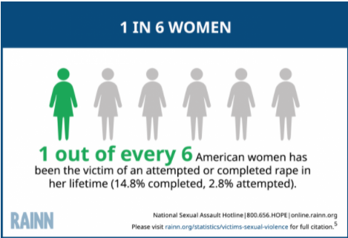
THE ISSUE OF SEXUAL ASSAULT: women

Slide 53
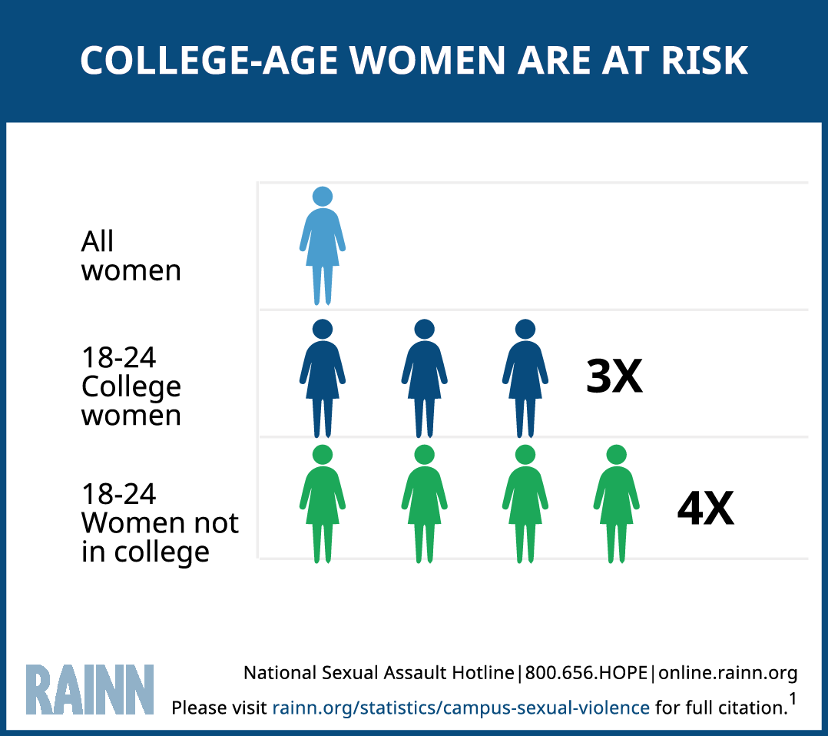
THE ISSUE OF SEXUAL ASSAULT: college-age women

Slide 54
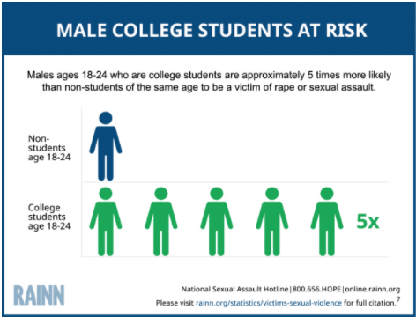
THE ISSUE OF SEXUAL ASSAULT: college men

Slide 55
THE ISSUE OF SEXUAL ASSAULT: students
13% of all students experience rape or sexual assault through physical force, violence, or incapacitation (among all graduate and undergraduate students).
21% of transgender, genderqueer, nonconforming (TGQN) college students have been sexually assaulted, compared to 18% of non-TGQN females, and 4% of non-TGQN males.
Among graduate and professional students, 9.7% of females and 2.5% of males experience rape or sexual assault through physical force, violence, or incapacitation.
Among undergraduate students, 26.4% of females and 6.8% of males experience rape or sexual assault through physical force, violence, or incapacitation.
5.8% of students have experienced stalking since entering college.
RAINN

Slide 56
THE ISSUE OF SEXUAL ASSAULT CONT.
More than 50% of college sexual assaults occur in either August, September, October, or November.
Freshmen and sophomores are at greater risk than upperclassmen (“red zone” during their first few months of their first and second semesters in college)
60% of sexual assaults of college students occurred on campus
10.3% took place in a fraternity
70% of females assaulted on campus knew their attacker
Students with disabilities experience assault 50% more frequently than students without disabilities
Sexual assault victim/survivors are more likely to suffer from depression and/or post-traumatic stress disorder, abuse alcohol and drugs, and/or contemplate suicide
RAINN

Slide 57
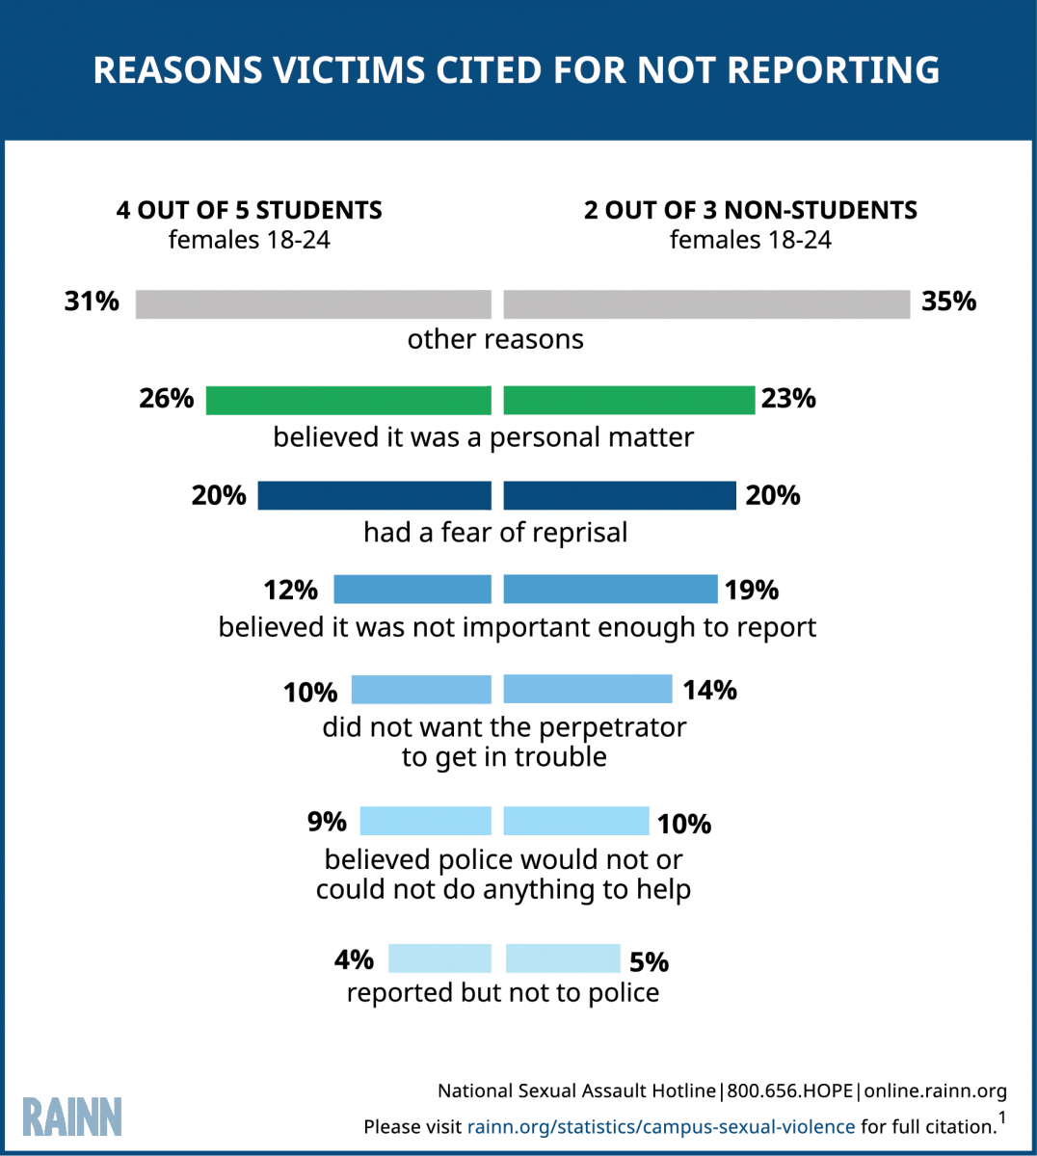
REPORTING SEXUAL VIOLENCE

Slide 58
Bias in Sexual Violence Investigations
Title IX requires a college or university to conduct a “prompt, thorough and impartial inquiry.”
Bias is defined as “to feel or show inclination or prejudice for or against someone or something.”

Slide 59
Investigator-Specific Biases
Complainant/Respondent is likeable/sympathetic
Complainant/Respondent is not likeable/sympathetic
Repeat Complainant/Respondent
Fact pattern similar to a prior, unrelated investigation
Complainant/Respondent behavior patterns

Slide 60
Cultural Considerations
Communication styles
Attitudes toward conflict
Approaches toward completing tasks
Decision-making styles
Approaches to knowing
Attitudes toward disclosure
  Appropriate to share emotions, reasons for conflict
                --Sue Ann Van Dermyden, 2017

Slide 61
Investigation Impact
Establishing rapport
Language may need to be altered
Storytelling style may need to be accommodated
  Linear versus circular styles
Recognize ethnocentric behaviors
  Assumption that own culture is “right” while others are “wrong”
Avoid stereotyping and assumptions
          --Sue Ann Van Dermyden, 2017

Slide 62
What other role might bias play in an Investigation?
Priming – Your pre-investigation or mid-investigation thoughts about the case
  “This is a really bad case.”
  “This person has complained three times before.”
  “This is low level.”
Phrasing – The way you ask a question can influence the answer – The misinformation effect
  Do you get headaches frequently, and if so, how often? 2.2/week
  Do you get headaches occasionally, and if so, how often? 0.7/week
  How long was the movie? 130 minutes
  How short was the movie? 100 minutes
        Headaches: Elizabeth Loftus (1975); Movie: Richard Harris (1973)

Slide 63
Sexual Violence Case Specific Biases
The subject matter of these cases is often personal and very intimate
Most of us hold our own conscious beliefs and practices when it comes to this content area so it is important not to intentionally or unintentionally cast your lens on the matters you investigate
  Your own sexual experiences
  Moral or religious views about sex
  Comfort level in using terms – subject matter

Slide 64
Alcohol and Drug Use Biases
You may have your own views on and experiences with:
  Alcohol use
  Drug use
These things may have impacted your life

Slide 65
Rape Myth Acceptance
Many studies have found that the higher the rape myth acceptance (stereotypical beliefs about rape), the more responsibility is attributed to the victim/survivor.
  The victim/survivor wanted it
  The person causing the harm didn't mean to
  Clothing
  Alcohol

Slide 66
Counterintuitive Behavior of Rape Victims
Delay in reporting
Change in account of what happened
Unexpected demeanor/disposition
Unexpected behavior
  Contact with person who caused the harm
  Resumption of normal routine
  Subsequent sexual activity (sometimes with the person who caused the harm)

Slide 67
Significant Time Between Incident And Report
The norm when the person causing the harm was not a stranger
Many victim/survivors are able to report only after they receive the necessary support to do so
Why do they wait? For many of the same reasons they later recant
  They fear repercussions
  They are pressured by others not to report
  They feel shame, embarrassment
  They are afraid of the person who caused the harm
  They are afraid of not being believed
  Fear that nothing will be done about it

Slide 68
Pre-Investigation planning

Slide 69
Pre-Investigation Steps
Review the report/complaint to determine potential process for investigation and/or resolution
Ensure appropriate individuals are informed and proper documentation of report/complaint (gatekeeping)
Ensure notice given to complainant of options and rights
Determine if there are any immediate needs and/or safety concerns that need to be addressed
Conduct intake with the complainant
Assess for supportive and interim measures
Begin to develop your investigation strategy

Slide 70
Notice of Complainant Options and Rights
Following a report of sexual violence, the complainant must be promptly notified of their options and rights, including, but not limited to:
How to obtain immediate medical assistance
Where and how to report incidents (college/university and law enforcement)
On- and off-campus resources, including counseling, mental health services, etc.
Right to report to law enforcement and rights under the crime victims bill of rights
Assistance available to preserving materials for investigation
- 1B.3.1 Procedure, Part 5., Subpart C. 3. and 4.

Slide 71
Interim Actions - Emergency Removal
Institution may remove a respondent from the education program or activity on an emergency basis if institution:
  Undertakes an individualized safety and risk analysis;
  Determines that an immediate threat to the physical health or safety of any student or other individual arising from the allegations justifies removal; and
  Provides the respondent with notice and an opportunity to challenge the decision immediately following removal

Slide 72
Offering Supportive Measures
Non-disciplinary, non-punitive individualized services
Offered as appropriate, as reasonably available, and without fee or charge to complainant or respondent
Before or after the filing of a formal complaint or where no formal complaint has been filed

Slide 73
Complainant Intake
Welcome and introductions
Review purpose of the intake meeting
Discuss the 1B.3 Policy and 1B.3.1 Procedure
Explain the process, resolution options, appeal rights, etc.
Inform complainant about retaliation prohibition under 1B.3.1 Procedure
Review the Data Privacy Notice (Tennessen Notice) and address confidentiality
Confirm complainant is a current student or attempting to participate in an education program or activity at the college/university where the complaint is being filed

Slide 74
Complainant Intake (Cont.)
Discuss availability of interim/supportive measures
Establish understanding of complainant’s intentions
    Do they want to tell their story or be heard?
    Are they requesting an investigation?
    Are they considering to submit a formal complaint?
Share campus and other available resources
If Complainant wants to file a formal complaint, explain process further and next steps dependent on resolution option they want to pursue.

Slide 75
Reluctant Complainants
If Complainant does not want to proceed with a formal complaint, consider factors that may necessitate a formal complaint by the Title IX Coordinator.
A Complainant may request confidentiality, that nothing be done, or say that they don’t want to participate in investigation. In response, consider whether to:
  Explain further confidentiality in the process
  Discuss further protections against retaliation in the policies/procedures
  Explain responsibility of institution to maintain safe and non-discriminatory environment, which may mean actions will be taken
  Explain what options are available if an investigation does not proceed
  Explain limitations in response without participation
Note: Document the Complainant’s request, any actions taken, and explanation of why an investigation was or was not pursued

Slide 76
Notice of Allegations
Upon formal complaint, provide written notice to both parties including:
  Statements that:
    Respondent is presumed not responsible
    Determination of responsibility is made at the conclusion of the 1B.3.1 process
    Right to advisor of choice who may be but is not required to be an attorney
    Parties may inspect and review evidence
    Inform parties of prohibiting knowingly making false statements

Slide 77
More on Notifications for Complainant and Respondent
Notice to Complainant regarding status of complaint
  Summary of allegations
  Applicable policies and procedures
  Resolution process or investigation notice
  Interim/Supportive measures taken (e.g. no contact directives, housing relocation, etc.)
  Prohibition of retaliation reminder
Respondent must be provided written notice of the existence and general nature of the complaint, as well as:
  Applicable policies and procedures
  Resolution process or investigation notice
  Interim/Supportive measures taken (e.g. no contact directives, housing relocation, etc.)
  Prohibition of retaliation

Slide 78
Conducting interviews With trauma informed care

Slide 79
Interview Environment
Ideal interview space is:
  Safe (physically and emotionally)
  Private
  Neutral (in location and décor)
  Comfortable (in furnishings and in size)
  Set up to promote dialog
  Designed to reduce distractions
Interview space should reflect environment free of:
  Elements of bias
  Conflicts of interest

Slide 80
Interview Prep
Consider dress/appearance
Consider language needs
Things to have on hand:
  Business cards/contact information for investigator(s)
  Written copies of campus and community resources
  Written copies of relevant policies and procedures
  Paper and pen for student to take own notes, if desired
  Device for taking photos (e.g. cell phone, digital camera)
Consider having on hand:
  Tissues
  Water (or other beverage to offer)
  Candy/mints
  Stress ball, slinky, etc. (No sharp objects)

Slide 81
Interviewing Tips: Self-Check
Attend to own non-verbal behaviors
    Focus on student, rather than on advisor, support person, attorney
    Present open posture
    Balanced eye contact
Practice active listening
Demonstrate empathy, but with proper boundaries
    Treat interviewee as a whole person recognizing their humanity
    Remain neutral
    Sample language
    Allow space for decisions
Be mindful of own reaction to triggering information
    Consult with colleagues to learn more about your own non-verbal cues

Slide 82
Interviewing Tips: Interviewee
Acknowledge interview may include sensitive, triggering and difficult discussion
Ask the interviewee to use their own language
Follow up on the meaning of slang terms (e.g. “hook-up”)
Be aware of language differences in how words may be defined given cultural and social backgrounds

Slide 83
Virtual Interviews
Use unique meeting IDs with passwords for each interview
Ensure privacy settings are enabled
Discuss ground rules for all parties (e.g. no recordings, breaks, etc.)
Ensure needed documents are readily available (policies, procedures, flowcharts, etc)
Close all unnecessary windows and silence notifications (e.g. incoming email alerts)

Slide 84
Framing the Interview
Welcome and introductions
Build rapport
Provide overview of the process and purpose of the meeting
    Explain investigatory process, resolution options/process, appeal rights
    Have written copies of these materials available
Review rights and options specific to interviewee role
    Complainant/respondent rights differ from witness
    Discuss confidential resources, availability of interim measures and supports, other available resources

Slide 85
Set Interview Expectations
Review roles of interview attendees (investigator, notetaker, interviewee, advisor)
Discuss process issues (e.g. Does the party intend to cooperate?)
Discuss note taking and access to investigatory information
Discuss how breaks will be handled, if needed

Slide 86
Goals of Questioning
Establishing a narrative and timeline of events
Clarify conflicting information
Understand how each involved party perceived the events

Slide 87
Tips for Questioning
Ask open-ended questions
Listen more than speaking, and be comfortable with silence
Allow time for people to answer questions
Use an appropriate tone
Identify conflicting information
Ask for clarification
Ask questions that reveal attitude and belief
Keep it simple

Slide 88
Determine What to Ask
Ask yourself:
  What information do I need to gather?
  Do I need to know more about the information?
  Will an answer to my question help me to understand what happened?
  Will getting an answer to this question inform the decision?
  What facts may be in dispute?
In framing the questions, be sensitive to the emotional states of both complainant and respondent, as well as other parties involved
Do not make assumptions about complainant’s fragility or vulnerability
Important/relevant questions should always be asked

Slide 89
Types of Questions
“What” questions ask for facts and details
“How” questions ask about the process, sequence of events, or focus on emotions
“Who/When/Where” questions ask for the specifics of the situation
Avoid:
“Why” questions that could be perceived as judgmental
Questions that imply judgment
Leading Questions
Multiple choice questions
Asking more than one question at one time

Slide 90
Examples of Leading Questions
Q1: Were you feeling stressed when you told your roommate what happened?
Q2: Were you drunk after having 7 drinks?
Q3: Were you worried after the complainant left your room?
How can we ask these questions differently?

Slide 91
Questions to Help Gain Clarification
Would you be willing to tell me more about…?
How did you feel about…?
What did you do after…? What happened then?
What did you mean when you said …?
What was your reaction to …?
How did you become involved in …?
What is your understanding of…?

Slide 92
Additional Questioning Tips
Ask them to physically demonstrate what happened as appropriate
Ask them to draw maps, diagrams, room layout, floorplan, etc
Ask them if they have documents or other evidence that they discuss, and ask them if they would be willing to share
Avoid interrupting
Observe body language
Consider cultural differences

Slide 93
Complainant Investigatory Interview
Minimize the number of interviews and interviewers
    Could be retraumatizing to have to retell story multiple times
Ask questions that speak to sensory elements of incident that may help with recalling details
    Sight, smell, taste, texture, sound, etc.
Ask questions that speak to emotional elements of incident that may generate recall of details
Allow complainant to express their feelings

Slide 94
Respondent Initial Meeting
Welcome and introductions
Review purpose of the initial meeting
Discuss the 1B.3 Policy and 1B.3.1 Procedure
Explain the process, resolution options, appeal rights, etc.
Inform complainant about retaliation prohibition under 1B.3.1 Procedure
Review the Data Privacy Notice (Tennessen Notice) and address confidentiality
Confirm Respondent is a current student
Consider Respondents may be reluctant to participate because they may be concerned of the impact on criminal proceedings

Slide 95
Initial Respondent Meeting (Cont.)
Discuss Respondent Options
  Right to a written response to the allegations
  Discuss other individuals that are permitted to accompany the respondent during investigative interviews and the extent of their involvement.
Notice respondent which type of complaint process Complainant has selected (Formal or Informal Resolution)
Explain the Informal Resolution process
Discuss supportive measures
Discuss timelines
Discuss any interim actions that may take place based upon the allegations of the complaint
Any additional information

Slide 96
Respondent Investigatory Interview
Undergoing an investigation may cause the Respondent to feel:
    Stressed
    Shame and/or embarrassment
    Anger
    Hopeless
Important to provide respondent with appropriate resources/support
    Respondent who feel supported may be more likely to participate in process
Trauma-informed practices may be appropriate to use with Respondents as well

Slide 97
Witness Interviews
Address confidentiality
Address prohibition against retaliation
Explain hearing involvement, if applicable
Connect to resources
Witnesses can:
    Fill in gaps in timeline
    Provide information about parties’ alcohol/drug use
    Provide information regarding observable behaviors indicating possible incapacitation
    Provide corroborating information to that provided by other parties

Slide 98
Cultural Considerations in Interviews
Continuum of honesty and face-saving
  Some cultures do not equate face-saving with an outright lie. Parties from such cultures may believe they you can read the context of when they are telling a story in a way to preserve someone’s dignity or privacy.
In-group/out-group rigidity or flexibility
  For cultures with rigid in-group/out-group boundaries, they may be very hesitant to disclose to someone outside of the group.
Linear v Non-linear narration
  Some may rely on linear storytelling, but others may have a culture of non-linear storytelling. Linear may appear cooperative, while non-linear may appear as obscuring the truth.
It is important to clarify any details that are not clear to you.

Slide 99
Gathering Information
Notetaking:
  Verbatim notes are not needed, but quotes can be helpful
  Notes should be thorough and clear
  Develop system of symbols to denote important items and indicate where follow up questions are necessary
  Clean up and finalize notes soon after interview
  Consider using dictation software to save time

Slide 100
Gathering Information (Cont.)
Documentary information can include:
  Text messages and call logs
  Photographs
  Social Media posts
  Video
  Building/swipe access records
  Medical records/SANE records
  Guest lists
  Bar or restaurant receipts

Slide 101
Closing the Interview
Connection to additional witnesses/information
    Do you have any texts, pictures, etc. that may be related to this incident?
    Is there anyone else you can think of that I should talk to? What information do you think they may be able to provide?
Wrap up questions
    Is there anything else you think I need to know?
    Is there anything you were expecting me to ask that I didn’t?
    Do you have any questions at this time?

Slide 102
Conclusion of the Interview
Thank them for their cooperation
Remind them of any action items
Give them your contact information in case they remember anything
Explain future procedures and timeline
Remind them about the prohibition of retaliation and procedure for reporting

Slide 103
Trauma Informed Interviewing
Most investigators and decisionmakers believe when a victim/survivor experiences trauma, the brain records most of the event including the “Who, What, Where, Why, When and How," as well as other details of the event
Most investigators are trained to obtain this type of information in interviews with victim/survivors
High-stress situations can result in a trauma response on the part of the victim
Source: http://www.army.mil/article/72055/Army_expert_receives_national_recognition_for_combating_sexual_assault

Slide 104
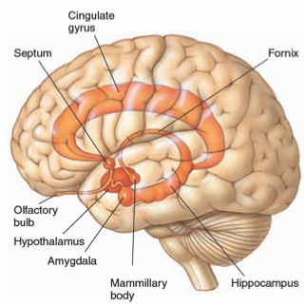
Neuroscience – The Limbic System

Slide 105
Responses of the Brain & Body During Trauma
Freeze
  Assess situation, avoid (more) attack
Flight and Fight
  Avoid (more) attack
When flight is impossible & fight useless……….
  Dissociation
    Protect from overwhelming sensations & emotions
  Tonic Immobility
    Last ditch effort to avoid (more) attack – or at least survive

Slide 106
Dissociation
Defense mechanism (of the brain) to protect against overwhelming sensations & emotions
  Occurs automatically, without trying
Portions (i.e., memories) of an experience that are normally linked together become “dis-associated”
Examples (during & immediately following a trauma):
  “Blanked out” or “spaced out” – in some way felt that I was not part of what was going on
  What was happening seemed unreal to me – like I was in a dream or watching a movie or a play
  Felt “disconnected” from my body

Slide 107
Tonic Immobility
Uncontrollable response
Mentally know what’s happening but physically unable to move (like being awake during surgery)
Rate of occurrence
  12 – 50% victim/survivors of rape experience tonic immobility during assault (most studies are closer to 50%)
Caused by:
  Fear
  Physical restriction
  “Perceived” inability to escape

Slide 108
Memory Fragmentation
Memory recall can be very slow and difficult (or not possible)
  Memories are “fragmented” – they come only in bits and pieces (often do not follow a timeline)
  Process can be very frazzling and frustrating for victims

Slide 109
Traumatic responses can alter…
Physiology
  Heart rate, respirations, dilated pupils, dry mouth, knot in the stomach
Affective (mood and emotion) responses
  Fear, helplessness, horror
Cognitive (thought) processing
  Memory – fragmented, out of sequence
  Time distortion
  Increased confabulation
  Trauma memory and recall

Slide 110
Trauma and Memory
The body and brain react to and record trauma in a different way than we believed traditionally
Many professionals were trained to believe that even when a person experiences a traumatic event, the pre-frontal cortex records the vast majority of the event including: Who, What, When, Where, Why, and How
The Forensic Experiential Trauma Interview, Strand & Heitman

Slide 111
Memory phenomenon in traumatic situations
During trauma incident: Sensory overload, fixation on a particular aspect, miss other things
Immediately after: “post incident amnesia”—failure to remember most of what was observed
After a healthy night’s sleep: “memory recovery”—result in remembering majority of what occurred; probably most ‘pure’ recollection
Within 72 hours: final & most complete memory—but at least partially reconstructed after normal process of integrating other sources of information
By Lt. Col. Dave Grossman & Bruce K. Siddle
The Firearms Instructor: The Official Journal of the International Association of Law Enforcement Firearms Instructors
Issue 31 / Aug 2001

Slide 112
The Impact of Trauma on Victim/Survivor Behavior
The effects of trauma can influence behavior of a victim/survivor during an interview
People are often reluctant to recall experiences that evoke negative feelings and emotions such as anger, fear, humiliation, or sadness
--Strand, 2013

Slide 113
Informal resolution Overview

Slide 114
Informal Resolution
Subpart A. Informal resolution. A college or university may offer an informal resolution process if a formal complaint is filed and after providing both parties a notice of allegations. The parties must voluntarily consent, in writing, to the informal resolution process. At any time before agreeing to a resolution, any party has the right to withdraw from the informal resolution process and resume the process with respect to the formal complaint. This procedure neither prevents nor requires the use of informal resolution by individuals who believe they have been subject to conduct in violation of Board Policy 1B.3. Informal resolution shall not be used to resolve allegations that an employee sexually harassed a student.

Slide 115
Informal Resolution (cont.)
Examples of Possible Educational and Restorative Activities
Mutual no contact
Mutual agreement to change classes or lab schedules
Agreements on occupying shared spaces
Residence community room reassignments and future assignments
Agreements on what to do off campus if the parties cross paths
Impact Statement
Education

Slide 116
Affirmative Consent

Slide 117
Affirmative Consent – 1B.3 Policy Language
What is Affirmative Consent?
Consent is informed, freely given, and mutually understood willingness to participate in sexual activity that is expressed by clear, unambiguous, and affirmative words or actions.
A lack of protest, absence of resistance, or silence alone does not constitute consent, and past consent to sexual activities does not imply ongoing future consent. The existence of a dating relationship between the people involved or the existence of a past sexual relationship does not prove the presence of, or otherwise provide the basis for, an assumption of consent. Whether the respondent has taken advantage of a position of influence over the complainant may be a factor in determining consent.

Slide 118
Affirmative Consent Questions Answered
Who has the responsibility to obtain affirmative consent?
Can affirmative consent be revoked?
Who can give affirmative consent?

Slide 119
Intoxication versus Incapacitation

Slide 120
Incapacitation is …
A state where a person cannot make an informed and rational decision to engage in sexual activity.
A person who was incapacitated due to the influence of drugs, alcohol, and/or medication and could not understand the fact, nature or extent of the sexual activity.

Slide 121
What are you evaluating?
Whether the complainant was incapacitated and, therefore, unable to give consent to sexual activity.

Slide 122
Areas of Inquiry
  Body weight, height and size;
  Tolerance for alcohol and other drugs;
  Gender
  Amount, pace and type of alcohol or other drugs consumed
  Signs of intoxication
  Food and non-alcoholic drinks

Slide 123
Assessment of Incapacitation
Obvious indicators
  Physically helpless?
    Difficulty with motor skills, like walking
  Unable to communicate?
    Cannot communicate consent to sexual activity
    Cannot communicate unwillingness to engage in sexual activity
    --Keith Rohman, 2017

Slide 124
Assessment of Incapacitation (continued)
Other indicators:
  Does the person know where they are or how they got there?
  Did the person do things in public that were out of character?
  Possible memory blackout
  Cannot verbalize coherently
  Bizarre or risky action
        --Keith Rohman, 2017

Slide 125
Assessment of Knowledge
If the investigator finds complainant was incapacitated, investigator must evaluate respondent’s level of knowledge of the level of incapacitation.
Assess whether the Respondent knew or reasonably should have known that the Complainant was unable to consent to the sexual activity.
--Keith Rohman, 2017

Slide 126
Analysis
1. What is the evidence that the complainant was under the influence of alcohol and/or drugs?
2. Did the alcohol and/or drugs cause the complainant to be incapacitated?
3. What did the respondent know, or what should the respondent have known, about the complainant’s level of intoxication and/or incapacitation?

Slide 127
Minnesota State Contact Information
Office of Equity and Inclusion (OEI)
http://www.minnstate.edu/system/equity/
Office of General Counsel (OGC)
http://www.minnstate.edu/system/ogc/

